Slide 1

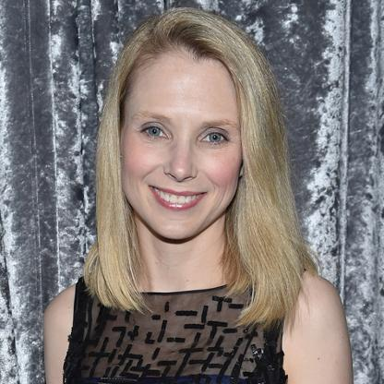

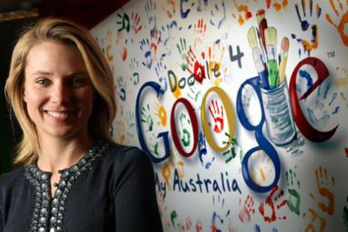
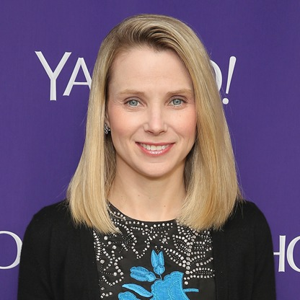
Women
Marissa Mayer
To change pictures:
Save the picture of the person you wish to use.
Single-left-click the grouped picture/shapes you wish to change on the poster. Single-left-click again on the picture.
Now single-right-click the picture and select “Change Picture” from the menu.
Choose the picture file you saved.
You may wish to single-left-click the grouped picture/shapes and single-left-click the new picture again to adjust its size or crop it—especially useful if the new picture is not the same aspect ratio as the previous one.
DO NOT CHANGE ROSIE THE RIVETER PICTURE!!!
In Technology
Self-described as “painfully shy” as a child, became president of high school Spanish club, treasurer of Key Club, and captain of state champion debate team
1999 Google User Interface Designer
2012 Yahoo CEO
She would recreate the technological circumstances of her users in her own life. Avoiding high-speed internet until major of US households had it. She would track, survey, and measure every user interaction with Google products, and then use that data to design and re-design.
“And she said, ‘I just knew that if I got to practice with the better players every day, I would become a much better player, even if I didn’t get to play in any of the games.’”
The moral of Mayer’s story is that it’s always better to surround yourself with the best people so that they will challenge you and you will grow.
What paths will you trailblaze that no one has traveled before?

